Slide 1
Stroke Risk Insights with Advanced Excel

Slide 2
agenda
INTRODUCTION
❖ OVERVIEW
❖ KPI’S
❖ INSIGHTS
❖ RECOMMENDATIONS
❖ SUMMARY
❖ CONCLUSION

Slide 3
introduction
OVERVIEW :This Stroke Risk Dashboard analyzes key factors like BMI, glucose levels, age, marital status, work type, gender, and residence type to understand their impact on stroke risk. The goal is to identify trends that can help in preventing strokes and improving health outcomes for specific groups.
OBJECTIVE : The objective of this project is to analyze and visualize factors influencing stroke risks, such as BMI, glucose levels, age, marital status, work type, gender, and residence type. By identifying trends and patterns, the project aims to provide actionable insights for healthcare professionals to target high-risk groups and develop strategies for stroke prevention and better health outcomes.
DATA SOURCE : The data source for this project likely includes health-related metrics such as BMI, blood glucose levels, age, gender, marital status, work type, and residence type, collected from medical records or health surveys. This dataset provides detailed information to analyze the relationships between these factors and stroke occurrences, enabling meaningful insights for identifying at-risk groups and understanding stroke risk patterns.

Slide 4

TOOLS USED
Microsoft Excel is a tool that helps you organize and work with data. You can use it to create tables, do calculations, make charts, and analyze information. It’s great for tasks like managing budgets, tracking projects, or creating reports. People use it at work, school, and home to handle numbers and data easily.

Slide 5
Where did you get the data from ?
Got it from open source

Slide 6
AIM OF THE PROJECT
The aim of this project is to analyze demographic and health-related factors to understand their relationship with stroke incidence. The project seeks to identify trends and correlations in a dataset that includes variables such as age, gender, health conditions, lifestyle habits, and other socioeconomic factors, enabling data-driven insights for healthcare decision-making and stroke prevention strategies.

Slide 7
KPIS FOR ANALYSIS
Average BMI: Tracks BMI across gender, work type, and marital status to identify high-risk groups for targeted health interventions.
Average Glucose Level: Monitors glucose levels by gender and work type to pinpoint groups prone to stroke risks from high glucose.
Stroke Counts: Measures stroke occurrences by residence and marital status to prioritize resources and prevention efforts.
Age Factor: Analyzes average age of stroke-prone individuals by marital status to develop age-specific prevention strategies.
Work Type Impact: Compares BMI and glucose levels by work type to identify health risks associated with specific professions.

Slide 8
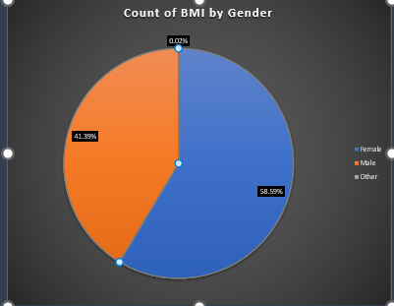
Count of BMI by Gender
KPI 1
The Count of BMI by Gender shows how BMI (Body Mass Index) is spread out across different genders. It uses a pie chart to show the number or percentage of BMI records for males, females, and possibly other genders. This helps to see if there are differences in BMI between genders, which can be important for understanding stroke risks and health issues. By looking at this, health experts can focus on specific gender groups to offer better advice and care.

Slide 9
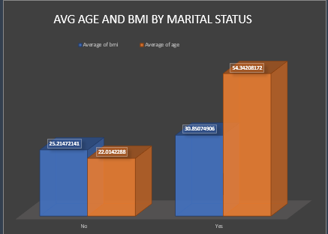
Avg Age and BMI by Marital Status
KPI 2
The Average Age and BMI by Marital Status section in the dashboard shows how the average age and Body Mass Index (BMI) vary between married and unmarried individuals. It helps to understand if there are differences in age or BMI based on whether someone is married or not. This information can help identify if marital status plays a role in stroke risks, with higher or lower averages in BMI and age linked to certain health trends.

Slide 10
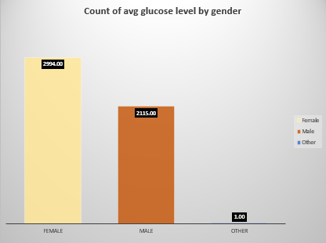
Count of avg glucose level by gender
KPI 3
The Count of Average Glucose Level by Gender chart shows the total glucose levels for different genders. From the chart, we can see that the average glucose level is much higher for females (2994) compared to males (2115), with a very low count for the "Other" category (1). This data helps in understanding how glucose levels may vary across genders, which is important for assessing stroke risk or other health conditions related to blood sugar.

Slide 11
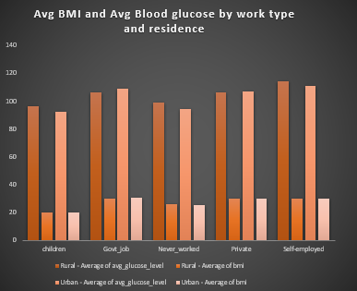
KPI 4
AVG BMI AND AVG BLOOD GLUCOSE BY WORK TYPE AND RESIDENCE
The Average BMI and Average Blood Glucose by Work Type and Residence chart shows how people's BMI and blood sugar levels change based on their job type and whether they live in an urban or rural area. It compares different jobs like government jobs, private work, or being self-employed, and looks at whether people live in cities or the countryside. This helps us understand if certain jobs or living areas are linked to higher or lower BMI and glucose levels, which can affect health and stroke risk.

Slide 12
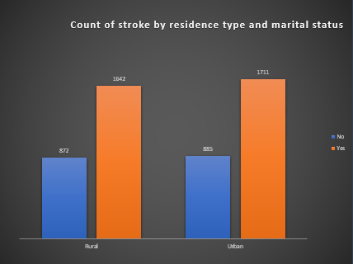
Count of stroke by residence type and marital status
KPI 5
The Count of Stroke by Residence Type and Marital Status chart shows how many strokes happened in urban and rural areas, and also compares married and unmarried people. This helps us see if strokes are more common in certain places or among married or unmarried individuals. It can help focus health efforts in areas or groups with higher stroke risks.

Slide 13
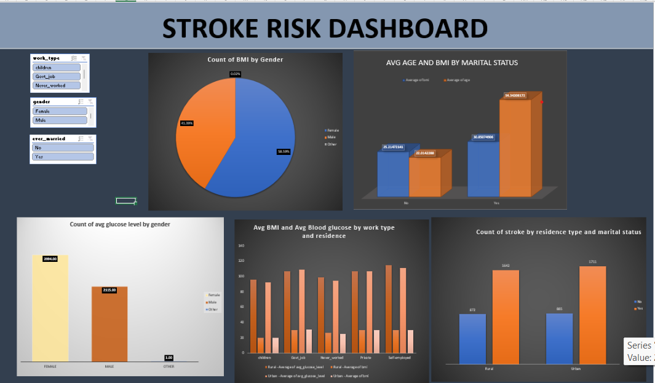

Slide 14
INSIGHTS OF PROJECT
The Stroke Risk Dashboard provides insights into how various factors like BMI, glucose levels, age, marital status, work type, and residence type impact stroke risk. By analyzing the Count of BMI by Gender, it reveals potential gender-based differences in BMI that could help identify high-risk groups for stroke prevention.
The Count of Glucose Level by Gender shows a significant difference in average glucose levels, suggesting that glucose control may be an important focus for reducing stroke risk, especially among females.
The Average Age and BMI by Marital Status section highlights how marital status might correlate with stroke risk factors like age and BMI, potentially guiding health interventions for married or unmarried individuals. The Average BMI and Blood Glucose by Work Type and Residence section provides valuable information about how occupation and living environment affect stroke risk, with certain work types or rural/urban living potentially influencing health outcomes.
the Count of Stroke by Residence Type and Marital Status shows patterns in stroke occurrences across different areas and marital statuses, helping to identify regions or groups that may need more targeted healthcare resources and awareness programs.

Slide 15
RECOMMENDATIONS
Based on the insights from BMI and glucose levels, create tailored health campaigns that focus on gender-specific and age-related risks. Encourage weight management, better glucose control, and regular screenings for high-risk groups.
work type influences BMI and blood glucose levels, recommend wellness programs or health check-ups in workplaces, especially for those in high-risk job categories. These could include initiatives like exercise routines, healthy eating plans, and stress management techniques.
Continuously collect and update data to monitor changes over time, which will allow for more accurate predictions and the ability to adjust health strategies as trends evolve. This will help keep the dashboard relevant and actionable for health professionals.

Slide 16
SUMMARY
The Stroke Risk Dashboard analyzes factors like BMI, blood glucose, age, marital status, work type, and residence to identify stroke risks. It provides insights into how these factors vary across genders, marital status, and living environments, helping healthcare professionals target high-risk groups for prevention and intervention. The dashboard aims to improve stroke risk awareness and guide personalized health strategies. The dashboard helps identify high-risk groups and areas, guiding healthcare professionals in creating targeted prevention strategies and interventions for reducing stroke risk.

Slide 17
CONCLUSION
The Stroke Risk Dashboard provides valuable insights into the relationship between lifestyle factors, demographics, and stroke risk. By analyzing data on BMI, glucose levels, and other factors across different groups, the project helps identify high-risk populations and areas that require focused health interventions.it supports targeted prevention strategies and emphasizes the importance of personalized healthcare in reducing stroke risk.This project highlights the critical role of lifestyle and demographic factors in stroke risk, offering a data-driven approach to prevention. It serves as a tool for healthcare professionals to better understand and address the specific needs of high-risk groups.

